Slide 1
Computerized Cognitive Retraining Program for Home Training of Children with Disabilities
CSE7101- Capstone Project
Review 5ROJECT EXPO
Batch Number: CAI 11
Roll Number | Student Name
20221CAI0085 | Manoj Kumar K R
20221CAI0070 | Gnaneshwar D Y
20221CAI0063 | Vikranth Reddy Y
Under the Supervision of,
Mr. J John Bennet
Assistant Professor
School of Computer Science and Engineering
Presidency University
Name of the Program: B.TECH
Name of the HoD: Dr. ZAFAR ALI KHAN N
Name of the Program Project Coordinator: Ms. SUMA N G
Name of the School Project Coordinators: Dr. Sampath A K , Dr. Geetha A

Slide 2
Problem Statement Number: PSCS_19
Organization: Ministry of Health
Category: Software(Web Application)
Problem Description:
Many children with cognitive disabilities have difficulty with attention, memory, executive function, and problem-solving. These challenges greatly affect their development, learning, and daily life. Traditional in-person therapy can be hard to access, schedule, and afford. There is a pressing need for a flexible, home-based solution that allows for effective and ongoing cognitive retraining.

Slide 3
Content
Introduction
Problem Statement
Objectives
Background and Related work for title Selection
Analysis of Problem Statement
Software Requirements
Innovation or Novel Contributions
Git-hub Link
References

Slide 4
Introduction
Children with cognitive disabilities often face challenges in attention, memory, and learning that require continuous retraining.
Traditional retraining therapy requires regular clinic visits, which may not be accessible due to distance, cost, or limited availability of specialists.
To address this challenge, Home-CogniPlay is developed as a computerized cognitive retraining system that allows children to practice scientifically designed cognitive tasks at home.
The platform includes:
Memory training activities
Attention and focus improvement games
Parent/Student dashboard for progress tracking
Therapist dashboard for monitoring and assessment
Session-wise performance analytics
Feedback submission and progress reinforcement
This system provides an affordable, accessible, and child-friendly digital therapy solution.

Slide 5
Problem Statement
Why the Project is Needed?
Children with cognitive disabilities (such as ADHD, LD, ASD) require continuous cognitive stimulation.
Challenges in the Current System:
Limited access to continuous therapy sessions
Manual therapy methods lack consistency
No real-time performance tracking
Difficulty for therapists to monitor home-based training
Parents cannot evaluate cognitive improvements
Impact if Not Solved:
Slow cognitive development
Poor academic performance
Reduced attention span
Behavioural issues
Increased therapy cost due to repeated sessions
This necessitates a child-friendly computerized retraining system that works from home with therapist oversight.

Slide 6
Objectives
To design a web-based cognitive retraining platform for children with
disabilities.
To provide memory and attention training tasks through interactive
games.
To enable home-based training supervised by parents.
To provide therapists with centralized dashboards for performance
analysis.
To record and visualize session data, scores, mistakes, and improvements.
To motivate children using performance rewards.
To store feedback for continuous improvement.
To ensure simple UI suitable for young users.
To support future expansion into more cognitive domains.

Slide 7
Background & Related Work
Research in cognitive rehabilitation shows that consistent practice improves:
Working memory
Attention span
Processing speed
Decision-making
Academic performance
Digital cognitive games are widely used in:
ADHD training
Learning disability support
Slow learner intervention programs
Existing tools (Lumosity, CogniFit, BrainHQ) are paid, complex, and not designed for Indian home-training for children.
Most do not include: Therapist dashboards, Parent-side tracking, Home training analytics, Culturally simple UI.
This gap motivated the development of Home-CogniPlay, a free, accessible, home-based system.

Slide 8
Analysis of Problem Statement
Child-Centric Issues
Poor attention span
Difficulty remembering instructions
Low motivation traditional therapy
Parent-Centric Issues
No expertise to conduct cognitive exercises
Cannot measure improvements
Need simple, guided digital tools
Therapist-Centric Issues
Cannot track home training
No centralized database
No real-time progress analysis
System-Centric Issues
No accessible home training platform
No automated session monitoring
No structured cognitive reporting

Slide 9
Software Requirements
The following tools and technologies are required for the development and deployment of the system:
Frontend Technologies
  React(Vite) – Ensures fast development environment and optimized production builds.
  CSS – Provides the core structure and styling of the web interface.
  JavaScript(ES6+) – Enables interactivity and dynamic client-side behavior.
  LocalStorage – Save feedback and auth tokens
DataBase and Backend Technologies
    Flask (Python) – API logic + session storage
    SQLite / SQL Database – Store cognitive sessions
    JWT – Secure authentication

Slide 10
Software Requirements
Version Control & Collaboration
GitHub – For source code management and team collaboration
Deployment Platforms
  Netlify – Cloud Hosting

Slide 11
Functional Architecture Overview
USER
↓
↓
Frontend (React + Vite)
↓
↓
Backend (Flask API+JWT Token)
↓
↓
SQLite Database (Data Storage)
↓
↓
Role Based Access Control (Parent/Child/Therapist)
↓
↓
Admin Dashboard Approval System
↓
↓
Approved data made visible to users

Slide 12
Innovation or Novel Contributions
Customizable, gamified training modules tailored for various disabilities with offline and online support to ensure accessibility and sustained child engagement.
AI-driven adaptive difficulty and detailed progress dashboards empower personalized learning and enable caregivers and therapists to monitor and optimize therapy effectively.
Home-based Cognitive Retraining
Children practice from home without visiting therapy centers.
Therapist Dashboard
View all users’ performance trends in one place.
Session Analytics
Includes: Mistake, count, Duration, Score, Average improvement.
Performance Rewards: Positive reinforcement to keep children motivated.
Difficulty Levels: Adaptive cognitive challenge.
Feedback System: User can submit feedback stored locally + optional email.

Slide 13
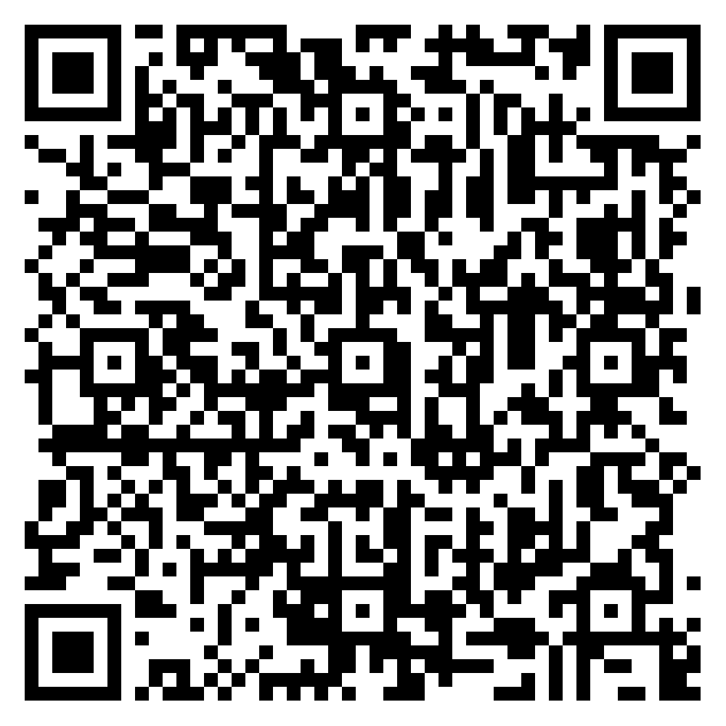
Github Link
https://github.com/ManojKumar-8055/Computerized-Cognitive-Retraining Program-for-Home-Training-of-Children-with-Disabilities.git
Website Link
https://home-cogniplay.netlify.app/

Slide 14
References (IEEE Paper format)
NCERT (n.d.) Including children with special needs. New Delhi: National Council of Educational Research and Training. Available at: https://ncert.nic.in/pdf/publication/otherpublications/SpecialNeeds.pdf (Accessed: 1 October 2025).
University of Alabama at Birmingham – Traumatic Brain Injury Model System (n.d.) In-home cognitive stimulation guidebook. Birmingham: UAB. Available at: https://uab.edu/medicine/tbi/images/TBIMS/PDF/Inhome_Cognitive_Stimulation_Guidebook_-_Final.pdf (Accessed: 1 October 2025).
JSS College of Physiotherapy (n.d.) Training manual for children with special needs. Mysuru: JSS College of Physiotherapy. Available at: https://jssphysiotherapy.edu.in/assets/documents/departments/Training_Manual_for_c hidlren_with_special_needs.pdf (Accessed: 1 October 2025).
Kumar, S., Sirisala, S., Babu, G.N., Ramakrishna, K. and Lakshmi, N.V.M. (2024) ‘Computerized Cognitive Retraining Program for Home Training of Children with Disabilities’, Proceedings of the 2nd International Conference on Sustainable Computing and Smart Systems (ICSCSS 2024). IEEE. DOI: 10.1109/ICSCSS60660.2024.10625417.

Slide 15
References (IEEE Paper format)
Prakash, P., Mukunth, J., Elangovan, K. and Dhanush Raja, A.K. (2024) ‘Computerized Cognitive Retraining Program for Children with Disabilities’, Proceedings of the 2024 International Conference on Power, Energy, Control and Transmission Systems (ICPECTS 2024). IEEE. DOI: 10.1109/ICPECTS62210.2024.10780401.
Nappo, R., Brancaccio, M., Pascotto, A. and Valenti, G. (2022) ‘Computerized training of executive functions in a child with specific learning disorders: A descriptive study’. Available at: https://www.researchgate.net/publication/366043186_Computerized_training_of_exec utive_functions_in_a_child_with_specific_learning_disorders_a_descriptive_study (Accessed: 1 October 2025).
Farghaly, A., El-Sayed, R., El-Kady, A. and Shaker, H. (2022) ‘Computerized program training for second-grade students with dyslexia in Asyut, Egypt’, Egyptian Journal of Neurology, Psychiatry and Neurosurgery, 58(57). DOI: https://doi.org/10.1186/s41983-022-00480-y (Accessed: 1 October 2025).

Slide 16


